Slide 1

Self Organizing Maps (SOMs)

Slide 2
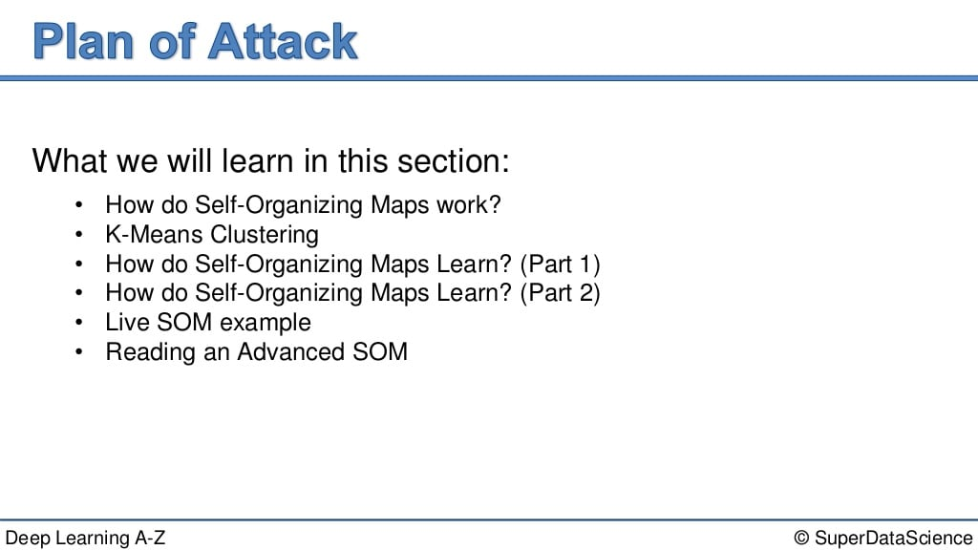
Content to be covered..

Slide 3
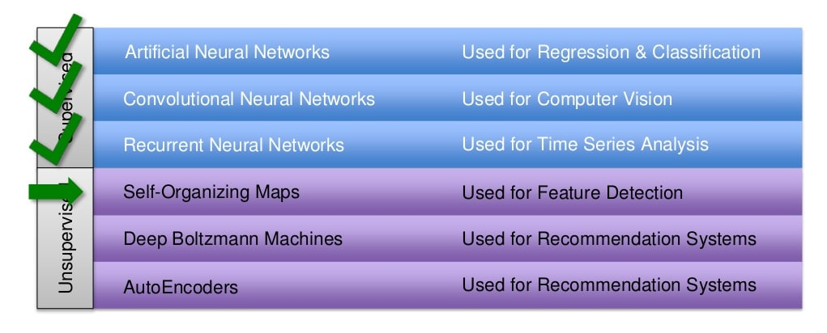
So far..

Slide 4
Introduction
A self-organizing map (SOM) is a type of ANN that is trained using unsupervised learning to produce a low-dimensional (typically two-dimensional), discretized representation of the input space of the training samples, called a map, and is therefore a method to do dimensionality reduction.
Self-organizing maps differ from other artificial neural networks as they apply competitive learning as opposed to error-correction learning (such as backpropagation with gradient descent), and in the sense that they use a neighborhood function to preserve the topological properties of the input space.

Slide 5
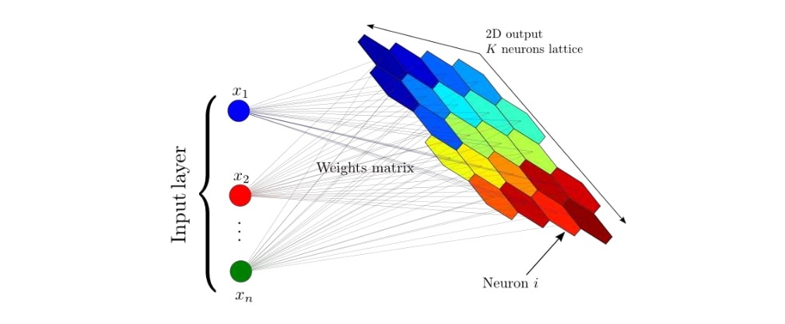
Understanding SOMs

Slide 6
Architecture
Self-Organizing Maps consist of two important layers, the first one is the input layer, and the second one is the output layer, which is also known as a feature map.
Each data point in the dataset recognizes itself by competing for a representation.

Slide 7
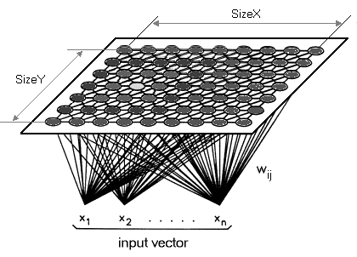
Structure

Slide 8
Explanation
A Self-Organizing Map (SOM) differs from typical ANNs both in its architecture and algorithmic properties.
Firstly, its structure comprises of a single-layer linear 2D grid of neurons, instead of a series of layers. All the nodes on this grid are connected directly to the input vector, but not to one another, meaning the nodes do not know the values of their neighbours, and only update the weight of their connections as a function of the given inputs.
The grid itself is the map that organises itself at each iteration as a function of the input of the input data.
As such, after clustering, each node has its own (i,j) coordinate, which allows one to calculate the Euclidean distance between 2 nodes by means of the Pythagorean theorem.

Slide 9
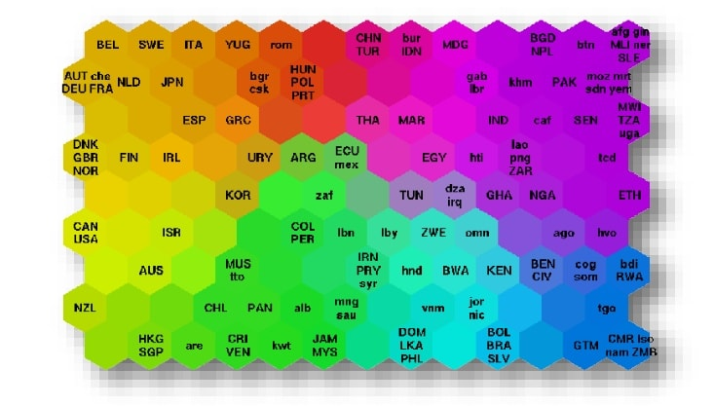
How do SOMs work?

Slide 10
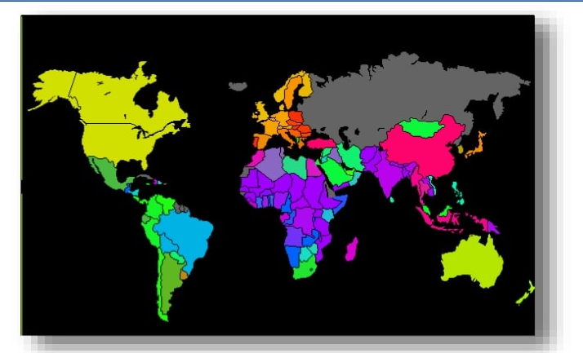
How do SOMs work?

Slide 11
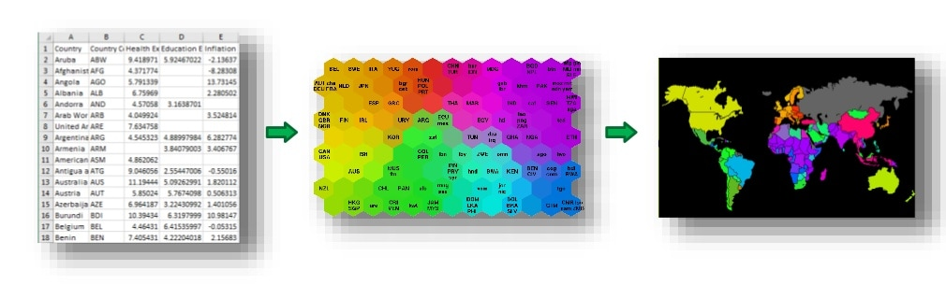
How do SOMs work?

Slide 12
Similar to K-Means …

Slide 13
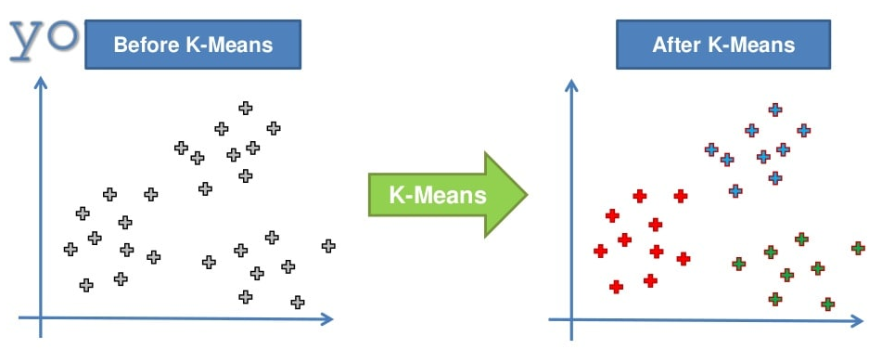
K-Means Algorithm

Slide 14
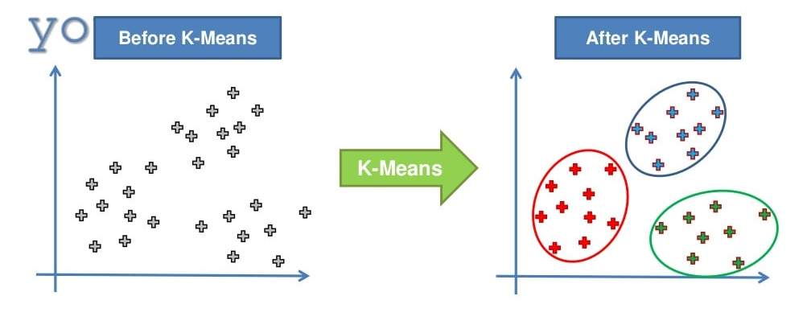

Slide 15
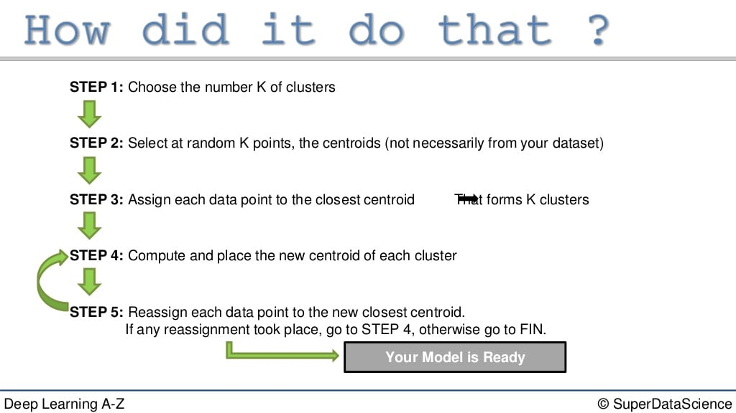

Slide 16
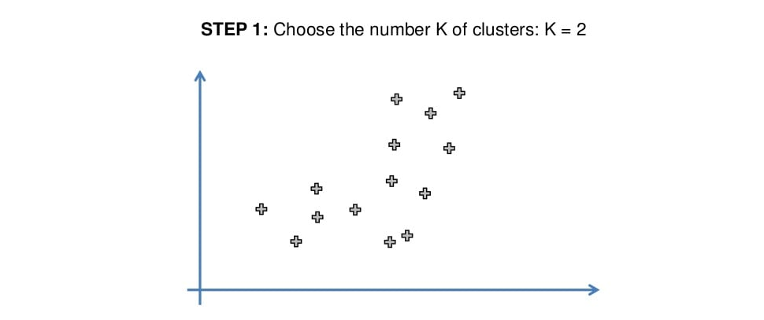

Slide 17
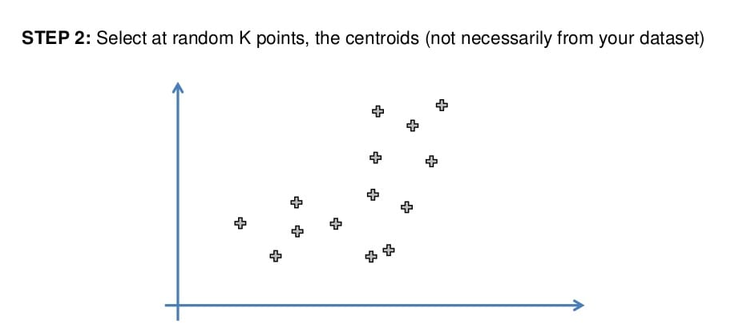

Slide 18
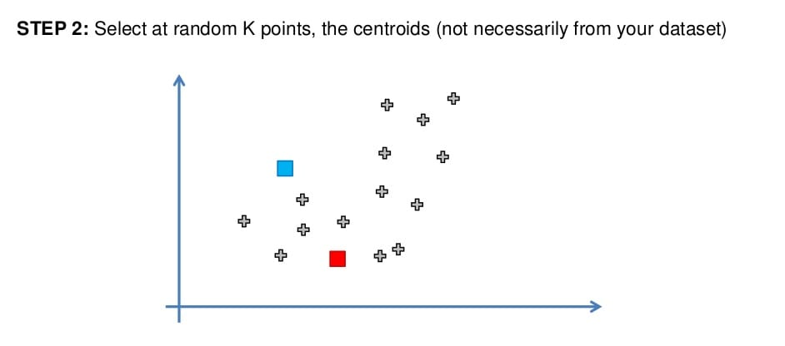

Slide 19
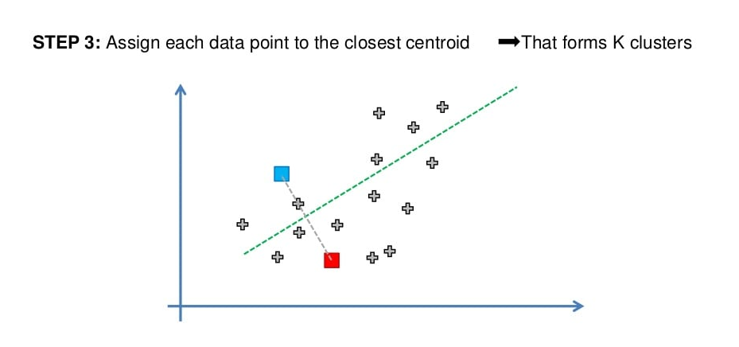

Slide 20
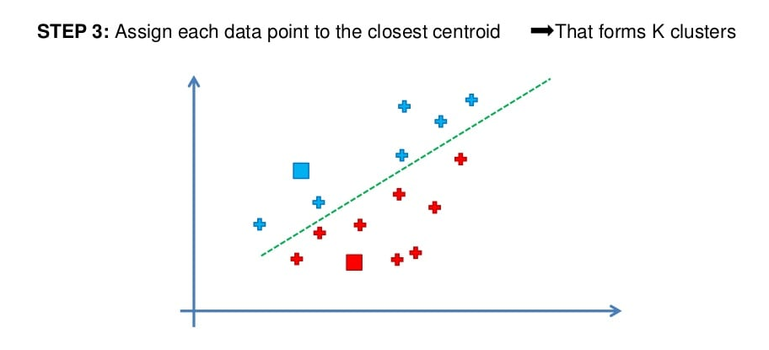

Slide 21
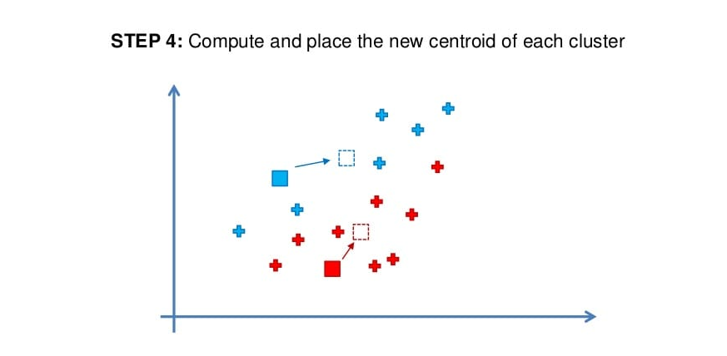

Slide 22
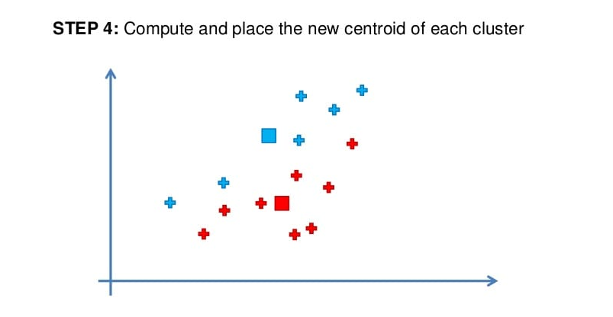

Slide 23
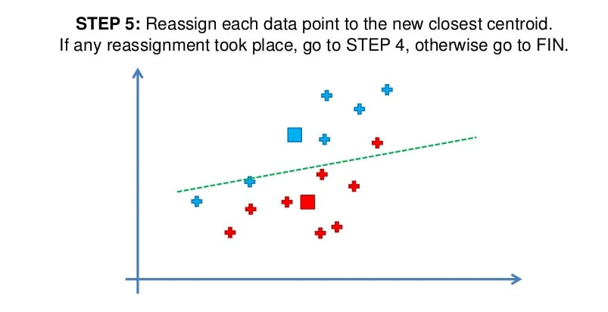

Slide 24
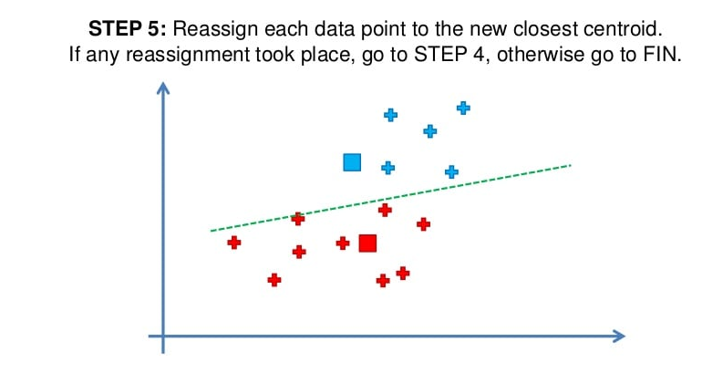

Slide 25
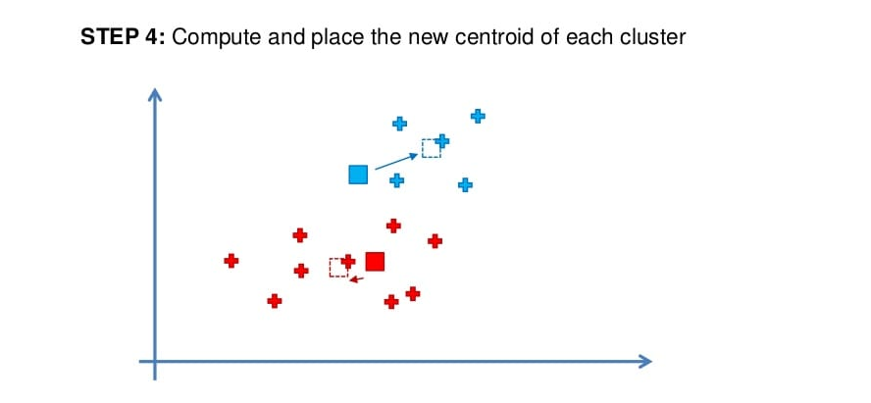

Slide 26
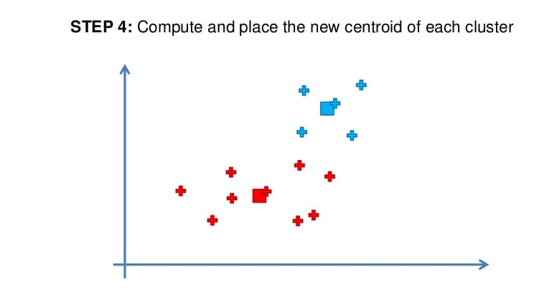

Slide 27
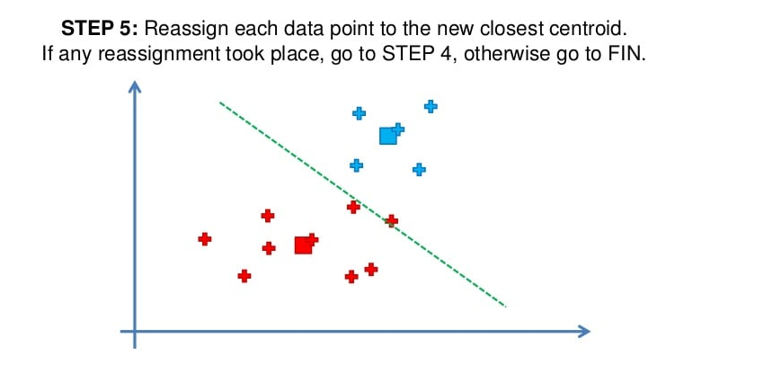

Slide 28
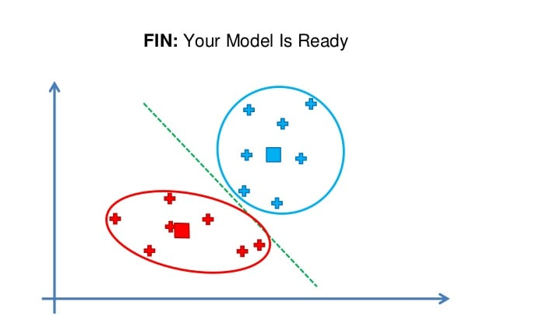
After a few iterations…

Slide 29
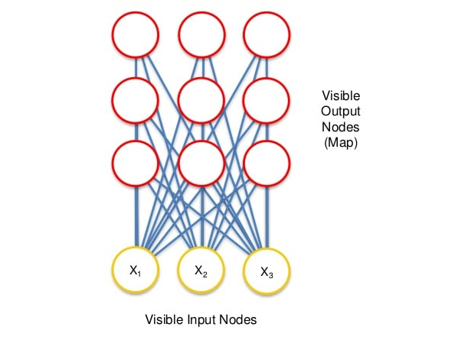
How do SOMs learn?

Slide 30
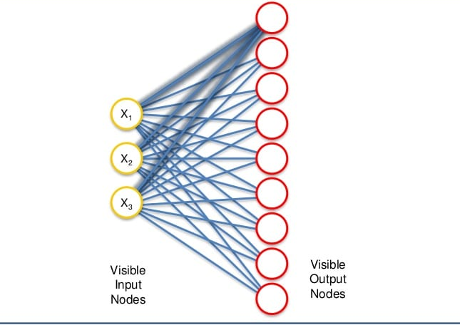
How do SOMs learn?

Slide 31
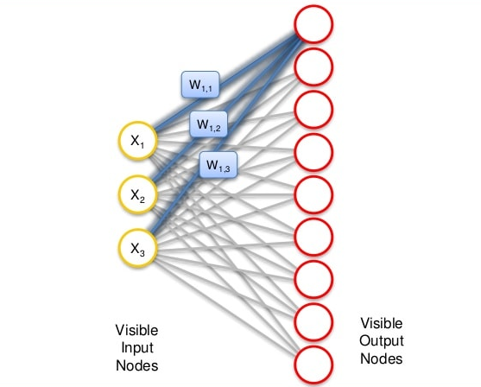
How do SOMs learn?

Slide 32
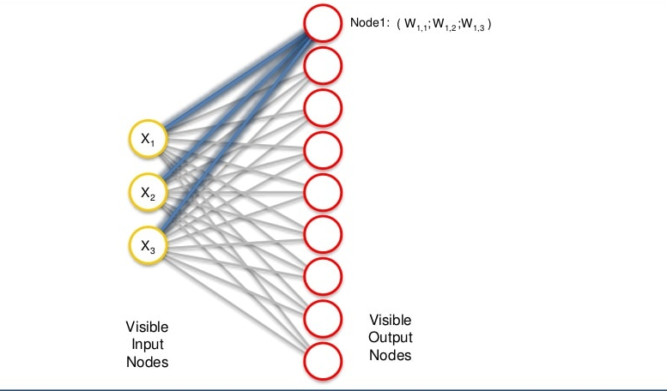
How do SOMs learn?

Slide 33
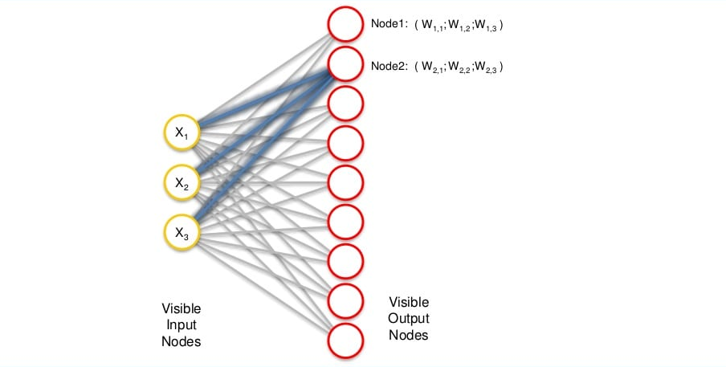
How do SOMs learn?

Slide 34
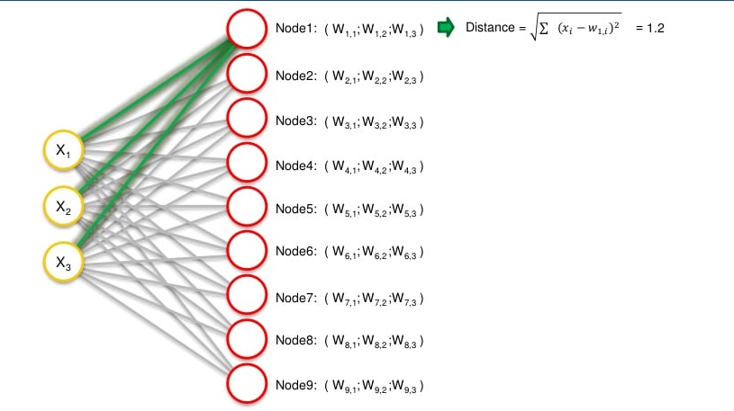
How do SOMs learn?

Slide 35
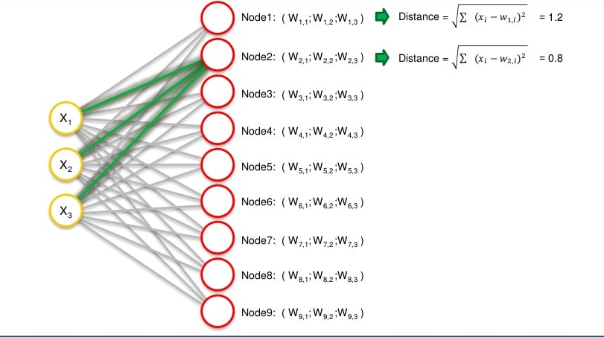
How do SOMs learn?

Slide 36
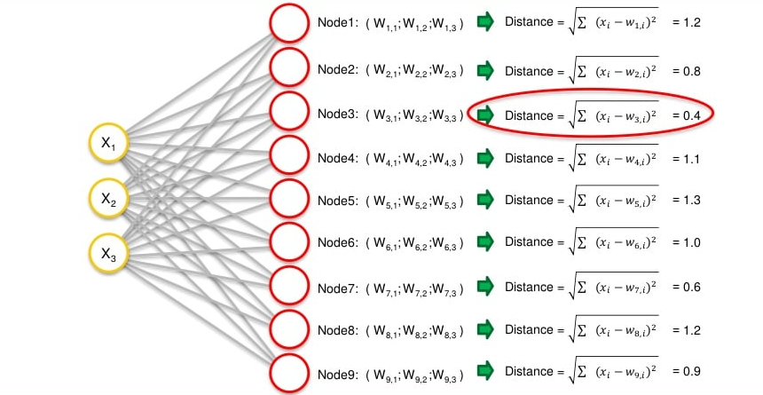
How do SOMs learn?

Slide 37
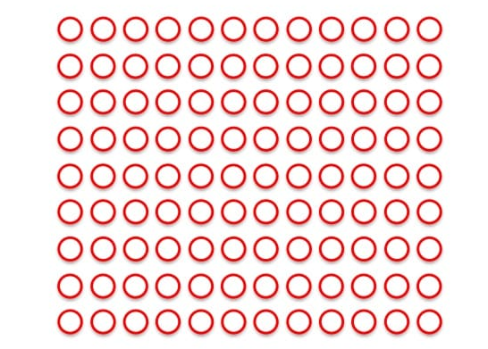
How do SOMs learn?
Select BMU

Slide 38
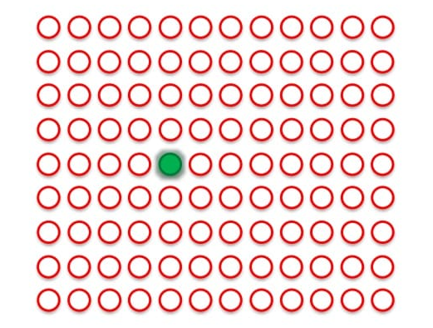

Slide 39
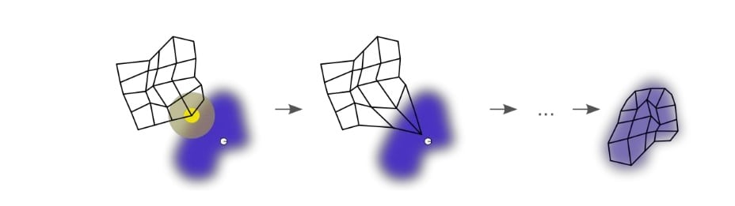
Learning Process
One more example -→ https://algobeans.com/2017/11/02/self-organizing-map/

Slide 40
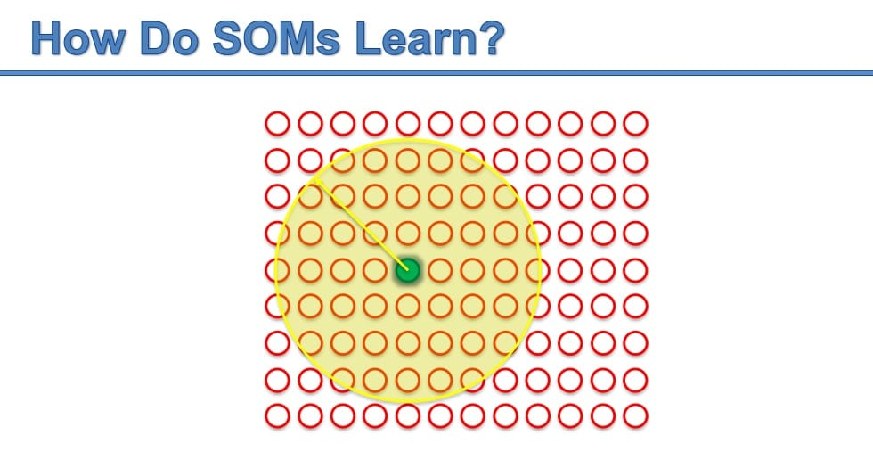

Slide 41
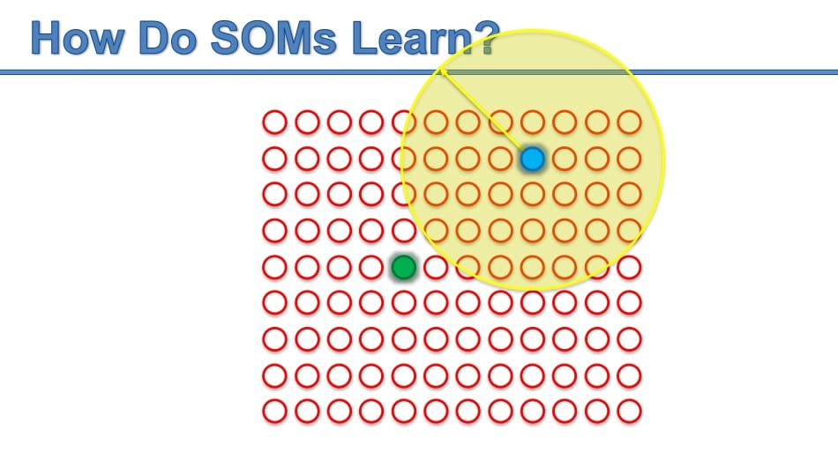

Slide 42
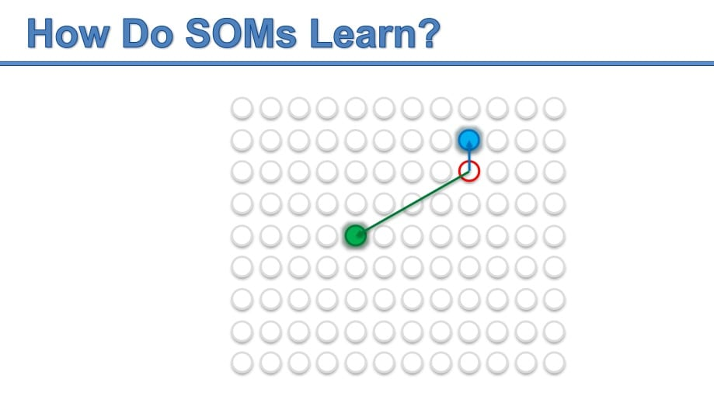

Slide 43

How do SOMs learn?

Slide 44
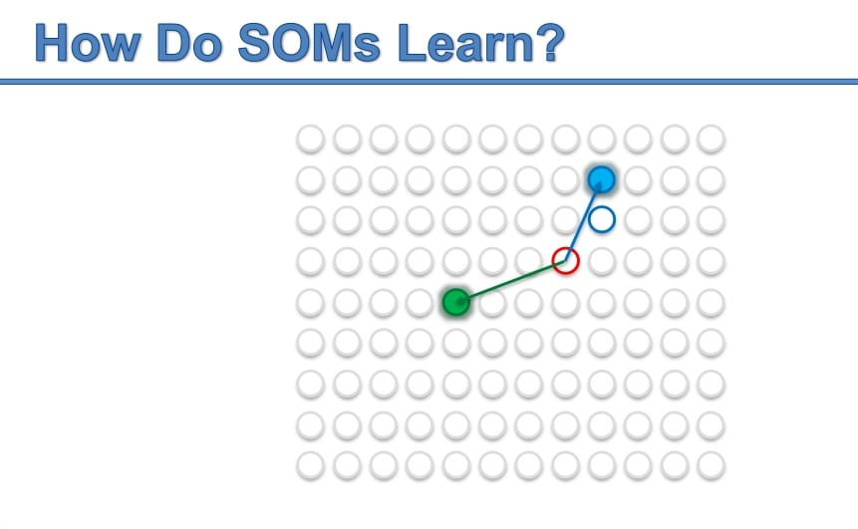

Slide 45


Slide 46
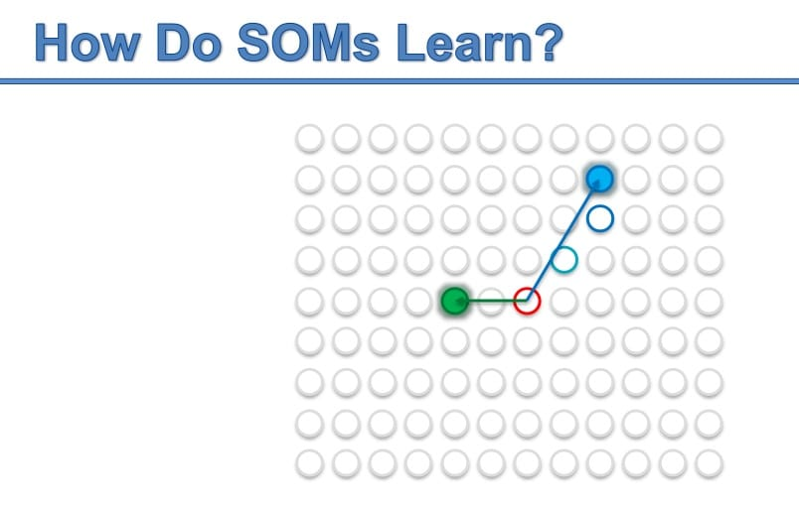

Slide 47


Slide 48
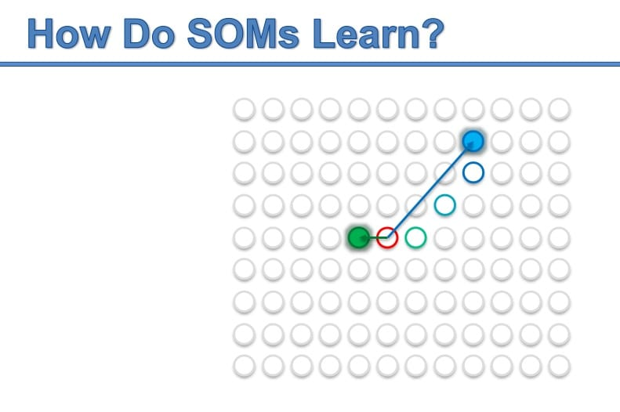

Slide 49


Slide 50


Slide 51
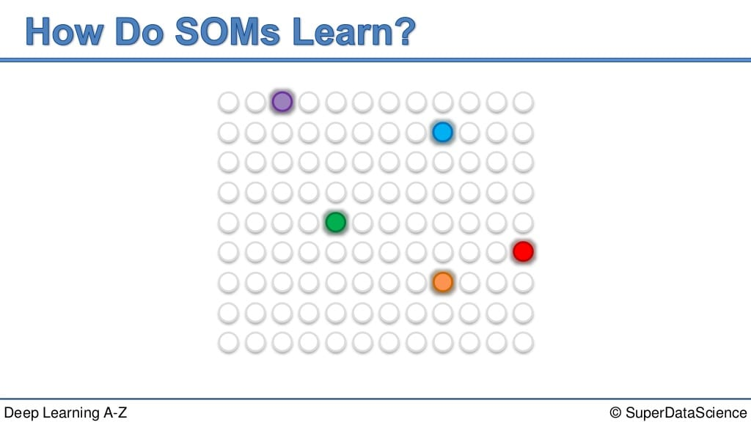

Slide 52
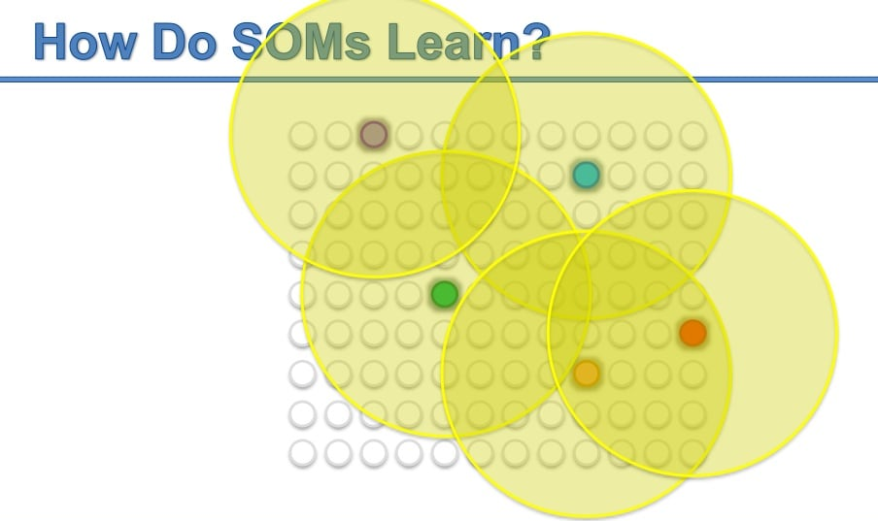

Slide 53
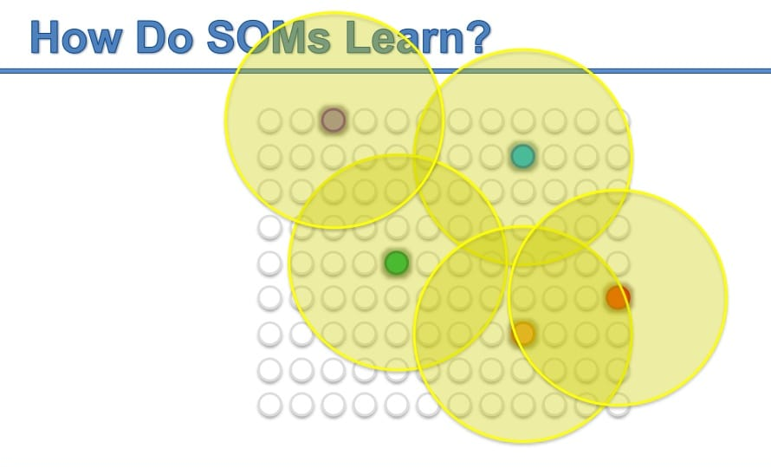

Slide 54
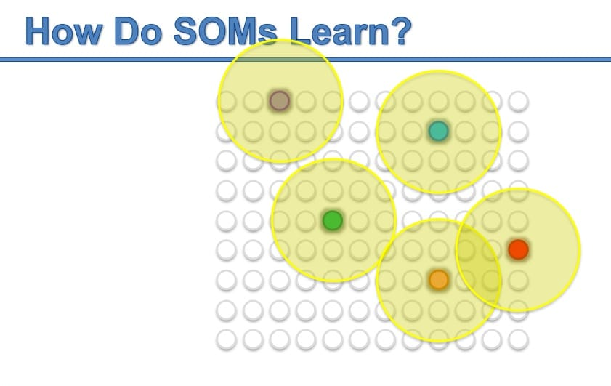

Slide 56
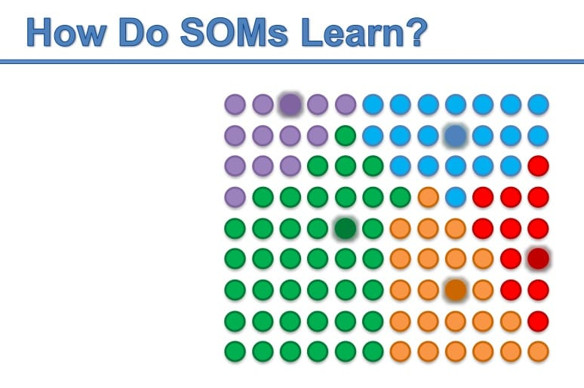

Slide 57
The Algorithm
Each node’s weights are initialized.
A vector is chosen at random from the set of training data.
Every node is examined to calculate which one’s weights are most like the input vector. The winning node is commonly known as the Best Matching Unit (BMU).
Then the neighbourhood of the BMU is calculated. The amount of neighbors decreases over time.
The winning weight is rewarded with becoming more like the sample vector. The nighbors also become more like the sample vector. The closer a node is to the BMU, the more its weights get altered and the farther away the neighbor is from the BMU, the less it learns.
Repeat step 2 for N iterations.

Slide 58
Explanation
this unsupervised ANN uses competitive learning to update its weights i.e Competition, Cooperation and Adaptation.
Each neuron of the output layer is present with a vector with dimension n.
The distance between each neuron present at the output layer and the input data is computed. The neuron with the lowest distance is termed as the most suitable fit.
Updating the vector of the suitable neuron in the final process is known as adaptation, along with its neighbour in cooperation.
After selecting the suitable neuron and its neighbours, we process the neuron to update. The more the distance between the neuron and the input, the more the data grows.

Slide 59
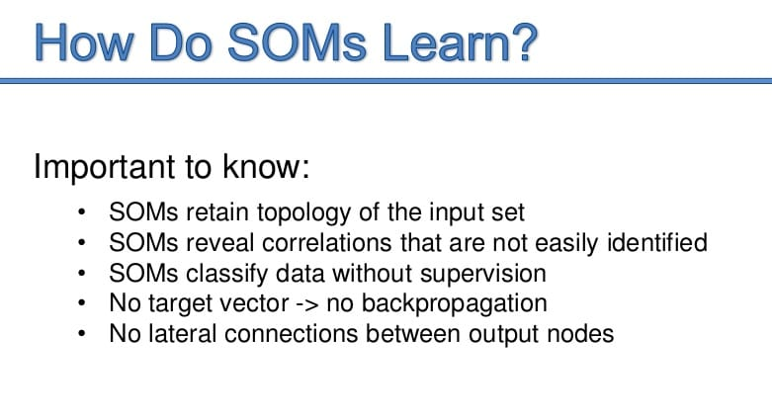

Slide 60
Practical SOM Example
http://www.ai-junkie.com/ann/som/som1.html

Slide 61
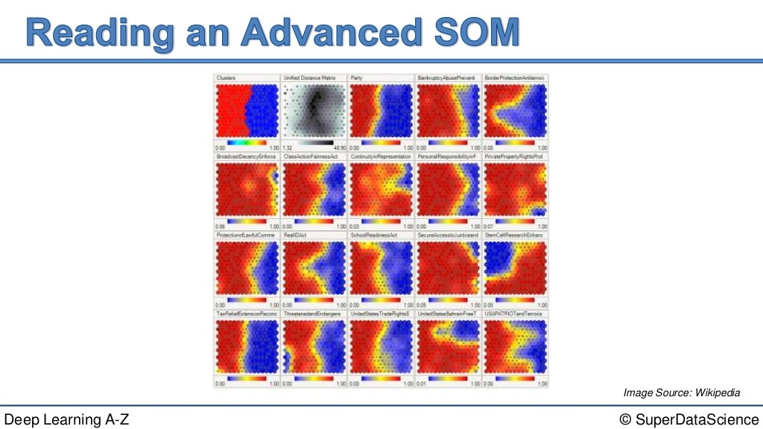
Another example

Slide 62
MUST READ
https://medium.com/@abhinavr8/self-organizing-maps-ff5853a118d4
With little bit mathematics → https://towardsdatascience.com/kohonen-self-organizing-maps-a29040d688da

